Slide 1
UNIVERSITY LIBRARY
EKITI STATE UNIVERSITY,
ADO-EKITI
A MEMORANDUM SUBMITTED TO THE ACADEMIC SUMMIT COMMITTEE ON THE CURRENT CHALLENGES CONFRONTING THE UNIVERSITY LIBRARY.

Slide 2
Introduction
The Ekiti State University Library was opened to readers in March, 1983.
The initial Library building which was originally conceived for 350 readers was later extended to enable it to accommodate 750 readers and at the same time, house more facilities.
It was designed to accommodate 750,000 volumes of books and periodical titles, government documents and other ephemerals.

Slide 3
Introduction Contd.
Due to the upsurge in the population of students in the years that followed, a three-floor Library with four wings was therefore designed to accommodate 3500 students and to be constructed in three phases.
The first phase of the Library was completed and movement of books and shelves was done in 2007.
The completed phase 1 of the Library has capacity for 1,000 students and 134,759 volumes of books including journals, government documents and other periodical tittles.

Slide 4
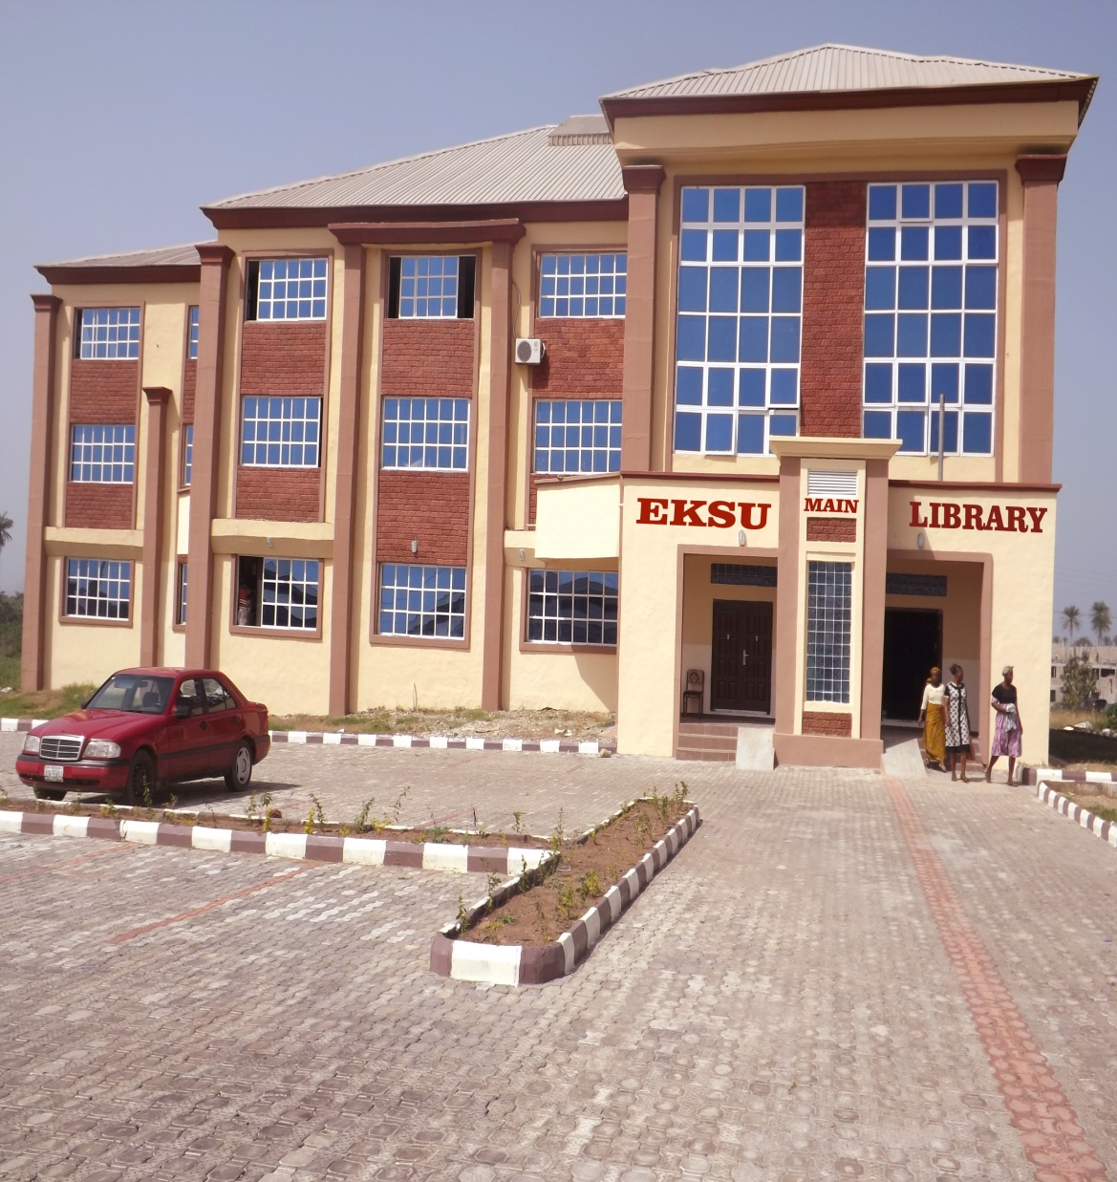
Main Library
The Library Building has been remodelled into a classical building which is very attractive to behold.

Slide 5
Faculty Libraries
In order to bring Library Services to the door steps of the students, and staff emphasis is now placed on Faculty Libraries and
Following Libraries are functional in the University:
Main Library
Agricultural Science Library
Education Library
Law Library
Medical Library
Science Library
Social Science Library

Slide 6
Awaiting
Management Science
Arts
CGDS
Engineering
For the avoidance of doubt, the University Librarian is statutorily in-charge of all the Libraries in the University.

Slide 7
CHALLENGES
The Challenges confronting the University Library are numerous and
Should be addressed holistically so as to enhance efficient and effective service delivery:

Slide 8
Staffing
The Library does not have sufficient staff to cope with the services provided to the users. Presently, the nominal roll is as indicated below:
Professional Librarians - 11
Administrative/Technical Staff - 36
Junior staff - 34
Total - 81
This number is grossly inadequate for both the Main Library and the Faculty Libraries.

Slide 9
Power Supply
Most of the time, the Library is in darkness. This is because the generators are managed by Library Assistants who are not professional Electricians.
The fans cannot work without electricity.
Therefore, the reading rooms are always dark and stuffy.
This situation discourages the readers from patronising the Library.

Slide 10
Toilet Facilities
The few Toilets available do not provide enough convenience for both staff and students.
Many students are turned off because of the absence of toilet facility.

Slide 11
Shift Duty and Extended Closing Hours
The Library is unable to operate shift duty because of the following problems:
Shortage of staff
Lack of electricity
Absence of a dedicated bus that will convey staff to the nearest bus stops in the evening/night – The University is non-residential.
Insecurity.

Slide 12
The Bindery
The Bindery unit of the University has not been commercialised
Inadequate staff and
Obsolete equipment.

Slide 13
E-Library
143 systems are in the library
110 in the e-library.
10 in the Law Library
23 in the Medical Library
The Library does not have dedicated bandwidth for speed despite the high demand for internet based services.

Slide 14

E-Library
The Library subscribe to the following databases
AGORA
AJOL
DOAJ
HINARI
HINDAWI
JSTOR
OARE
The library has a website www.eksulibrary.edu.ng
The Library has an OPAC with over 17,000 entries

Slide 15
Lack of Office Accommodation
Most of the Faculty Libraries lack office accommodation for the Librarians.
Even the space provided are not standardized.

Slide 16
Academic Activities Not Digitalized
The activities in the University Libraries have not been digitalized.
The University still maintain the culture of obtaining hard copies of thesis and submitting same to the Library.

Slide 17
Lack of Institution Repository
There is no institution repository where
  electronic copies of grey resources or
  papers presented within the University environment can be deposited.

Slide 18
No Provision for Physically Challenged
The Library has no provision for students with disabilities.

Slide 19
SUGGESTIONS/
RECOMMENDATIONS
Although these challenges abound in
University Library, they are surmountable.

Slide 20
Most of the challenges are hinged on inadequate staffing.
Therefore, it is suggested that more staff should be employed and deployed to the Library to improve the quality of services rendered to the users.

Slide 21
No of staff on ground/additional no required
S/N | Category | No on Ground | Additional No Required
1. | Professional Librarians | 11 | 4
2. | Library Officers | 9 | 10
3. | Library Assistants | 26 | 20
4. | Library Attendants | - | 10
5. | Administrative/ Technical Staff | 11 | 6
6. | Junior Staff (Porters and Cleaners) | 24 | 15
 | Total | 81 | 65

Slide 22
In order to improve on the quality of the power supplied to the main Library:
Professional Electrician should be deployed from Works & Services Department to take charge of the three (3) power generating sets servicing the main Library as well as the e-libraries.
He will be saddled with the task of maintaining the generators and ensuring that there is regular power supply to the library.

Slide 23
The existing toilets in the Library should be made functional by ensuring that water runs freely from the storage tank.
There is the need to build a detached toilet to supplement the existing ones which are inadequate, taking cognisance of gender sensitivity.

Slide 24
If there are constant supply of electricity, enough staff, and a standby bus dedicated to convey staff to their nearest bus-stop at the closing time, particularly in the night and during the weekend, it will be possible to operate shift-duty and extend the closing hours.

Slide 25
The Bindery Unit is a potential money generating unit.
It is recommended that six (6) professional binders be appointed to cope with a minimum of 5,000 students’ project.

Slide 26
E-Library
For the e-library to perform at optimal capacity, the following steps are recommended:
Replacement of the damaged cables
Provision of 2Mbps internet bandwidth
Subscription to reputable database e.g. EBSCOHOST, Science Direct, LexisNexis, etc.

Slide 27
Most faculty Libraries have spaces for readers only.
It is recommended that the Librarians should be provided with office accommodation for optimal performance.

Slide 28
POSITIVE DEVELOPMENTS
Despite colossal challenges confronting the University Library, there have been some positive developments.

Slide 29
Registration of Library Users
Library users were not enjoying ‘loan and return’ privileges from the library since the inception of this University until March 2015 when the Library began to register its clientele.
This registration exercise affords the Library users (staff and students) the opportunity to have full access to the Library collection.
For the first time in the history of the University, readers can borrow books for home use for a certain number of days.

Slide 30
Loan and Return’ Privileges
The challenge here is that
staff can only borrow 4 books at a time while
undergraduates can borrow one (1) book.
This is grossly inadequate.
Staff- 10 books
Post Graduate Students - 6 books
Undergraduates
- 4books
Existing Practice
Proposal

Slide 31
MoU Between ITOCA & EKSU
A Memorandum of Understanding (MoU) was signed between Information Training and Outreach Centre for Africa (ITOCA) and Ekiti State University (EKSU) under the Essential Electronic Agricultural Library (TEEAL) Leadership Programme (2015).
TEAL is produced by Cornell University’s Albert R. Mann Library to help Scientist have access to the world’s most important scholarly science journals that are up-to-date and accessible offline.

Slide 32



Memorandum of Understanding
Information Training and Outreach Centre for Africa
Ekiti State University

Slide 33
MoU Contd.
The TEEAL machines received through the MoU have been installed in the Faculty of Agricultural Science. The tool will enable academic staff of the Faculty to access information on their fields.
TEEAL machines contains 350,000 + full-text articles in PDF, 325 + journals, 80 + Publishers. It covers Agriculture and over 10 related Sciences and it is updated every year.

Slide 34
Training of Staff
Three (3) of the Library ICT staff attended the Train-the-Trainers Workshop organised by ITOCA which was held at the University of Ibadan from May 18th to 22nd, 2015.
In addition, another three (3) of the Library staff were sponsored to attend the workshop organised by the Librarian Registration Council of Nigeria (LRCN) held at the University of Ibadan from June 28th to July 4th, 2015.

Slide 35
More to Come
Another training session is being proposed for May 2016 in EKSU, Ado-Ekiti.
We are optimistic that more MoUs would be signed with some other reputable Organisations which will be of immense academic benefit to the University.

Slide 36
CONCLUSION
There will be significant improvement in the quality of services rendered in the University Library, if the challenges militating against effective service delivery identified in this presentation are removed.
Staff will be motivated to put in their best while the users will be encouraged to patronize the Library.

Slide 37


